Slide 1
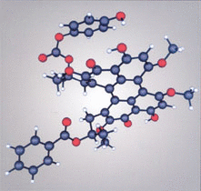
Lecture 10. Beyond Homonuclear Diatomics

Slide 2
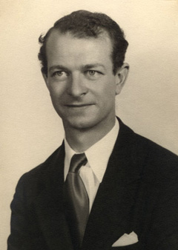
Linear combination of atomic orbitals within an atom leading to more effective bonding
Hybridization
2p_{z}
2p_{x}
2p_{y}
2p_{x}
2p_{y}
γ 2s+δ 2p_{z}
α 2s+β 2p_{z}
2s
The coefficients α, β, γ and δ depend on field strength
Square of a coefficient = contribution of that AO in the hybrid orbital
Equivalent hybrid orbitals (same s-contribution, same p-contribution in each hybrid orbital) have same energies
Hybrid orbitals are ortho-normal to each other
Hybridization origintes in VBT and relies on experimental results

Slide 3
Heteronuclear Diatomics: CO
π-acceptor
σ∗
p_{x}, p_{y}
π∗
2p
2s
h2
p_{x}, p_{y}
σ_{nb}
2p
2s
h1
π
h4
σ
h3
σ_{nb}
σ-donor
C
O

Slide 4
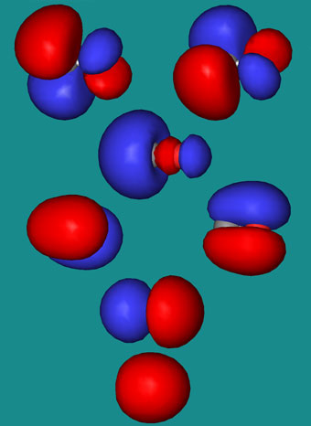
http://www.meta-synthesis.com/webbook/39_diatomics/diatomics.html
Heteronuclear Diatomics: CO
π-acceptor
σ∗
p_{x}, p_{y}
π∗
2p
2s
h2
p_{x}, p_{y}
σ_{nb}
2p
2s
h1
π
h4
σ
h3
σ_{nb}
σ-donor
C
O

Slide 5
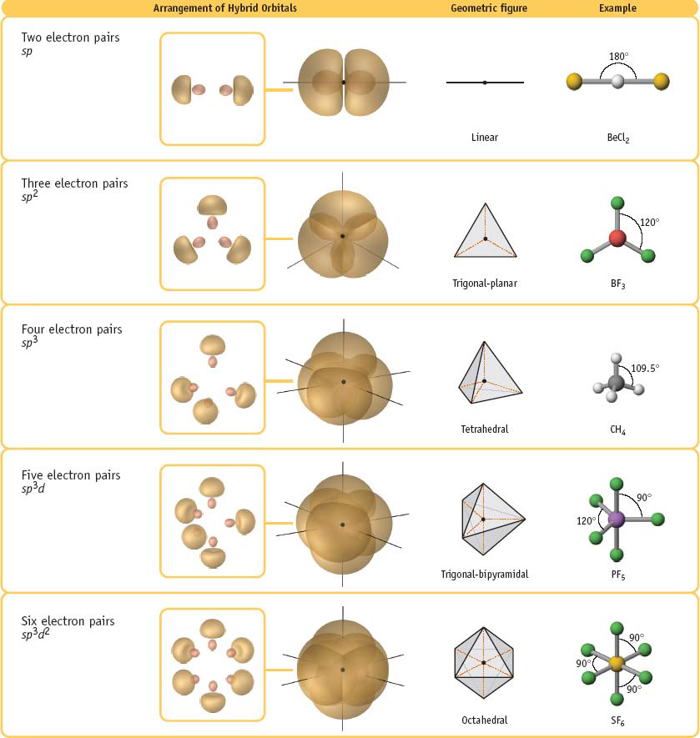
Polyatomic molecules: Geometry

Slide 6
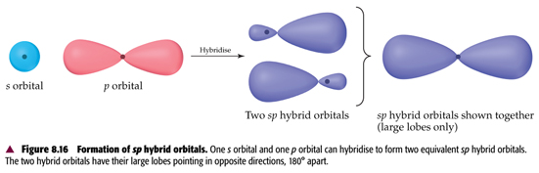

s+p (sp) hybridization
s and p orbital of the SAME atom!
No question of S (overlap integral)
2 equivalent hybrid orbitals of the same energy and shape (directions different)
Linear geometry with
Hybridized atom at the center
Contribution from s = 0.5; contribution from p = 0.5

Slide 7
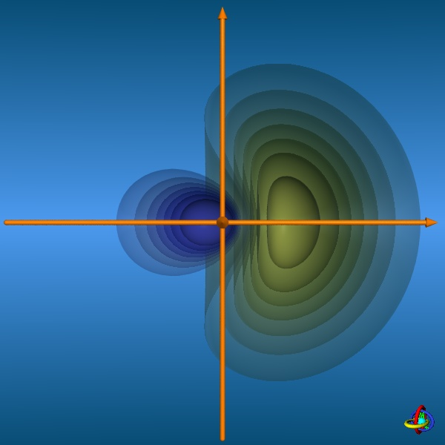
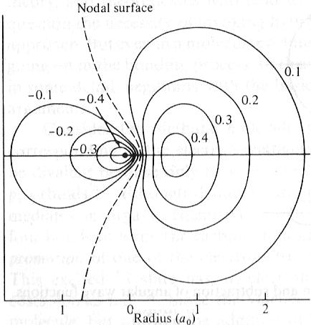
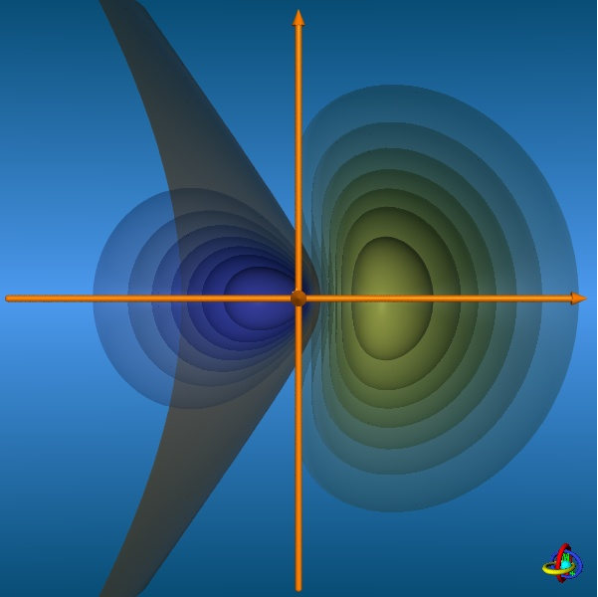
Contours of a sp hybrid orbital
http://csi.chemie.tu-darmstadt.de/ak/immel/script/redirect.cgi?filename=http://csi.chemie.tu-darmstadt.de/ak/immel/tutorials/orbitals/

Slide 8
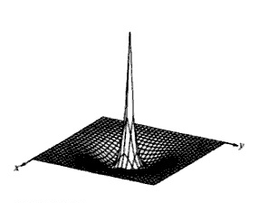
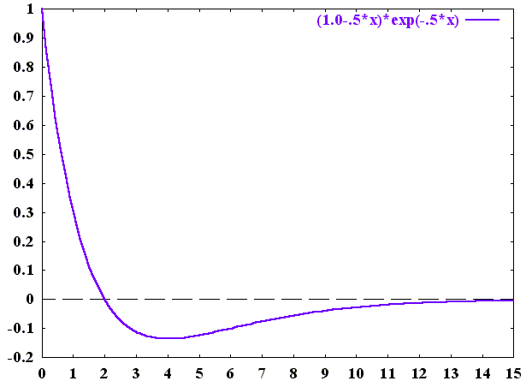
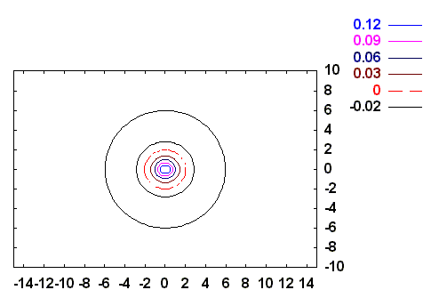
2s orbital
radial node
Y. U. Sasidhar

Slide 9
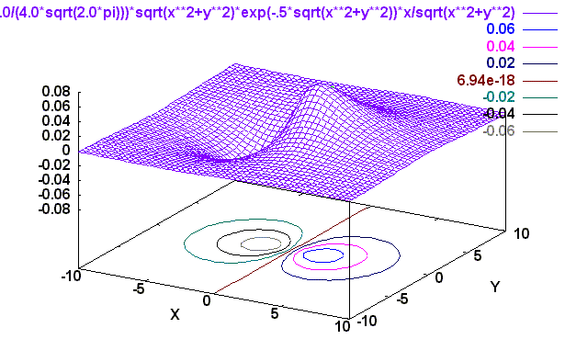
2p_{z} orbital
Angular Part
(2,1,0)
X
Z

Slide 10
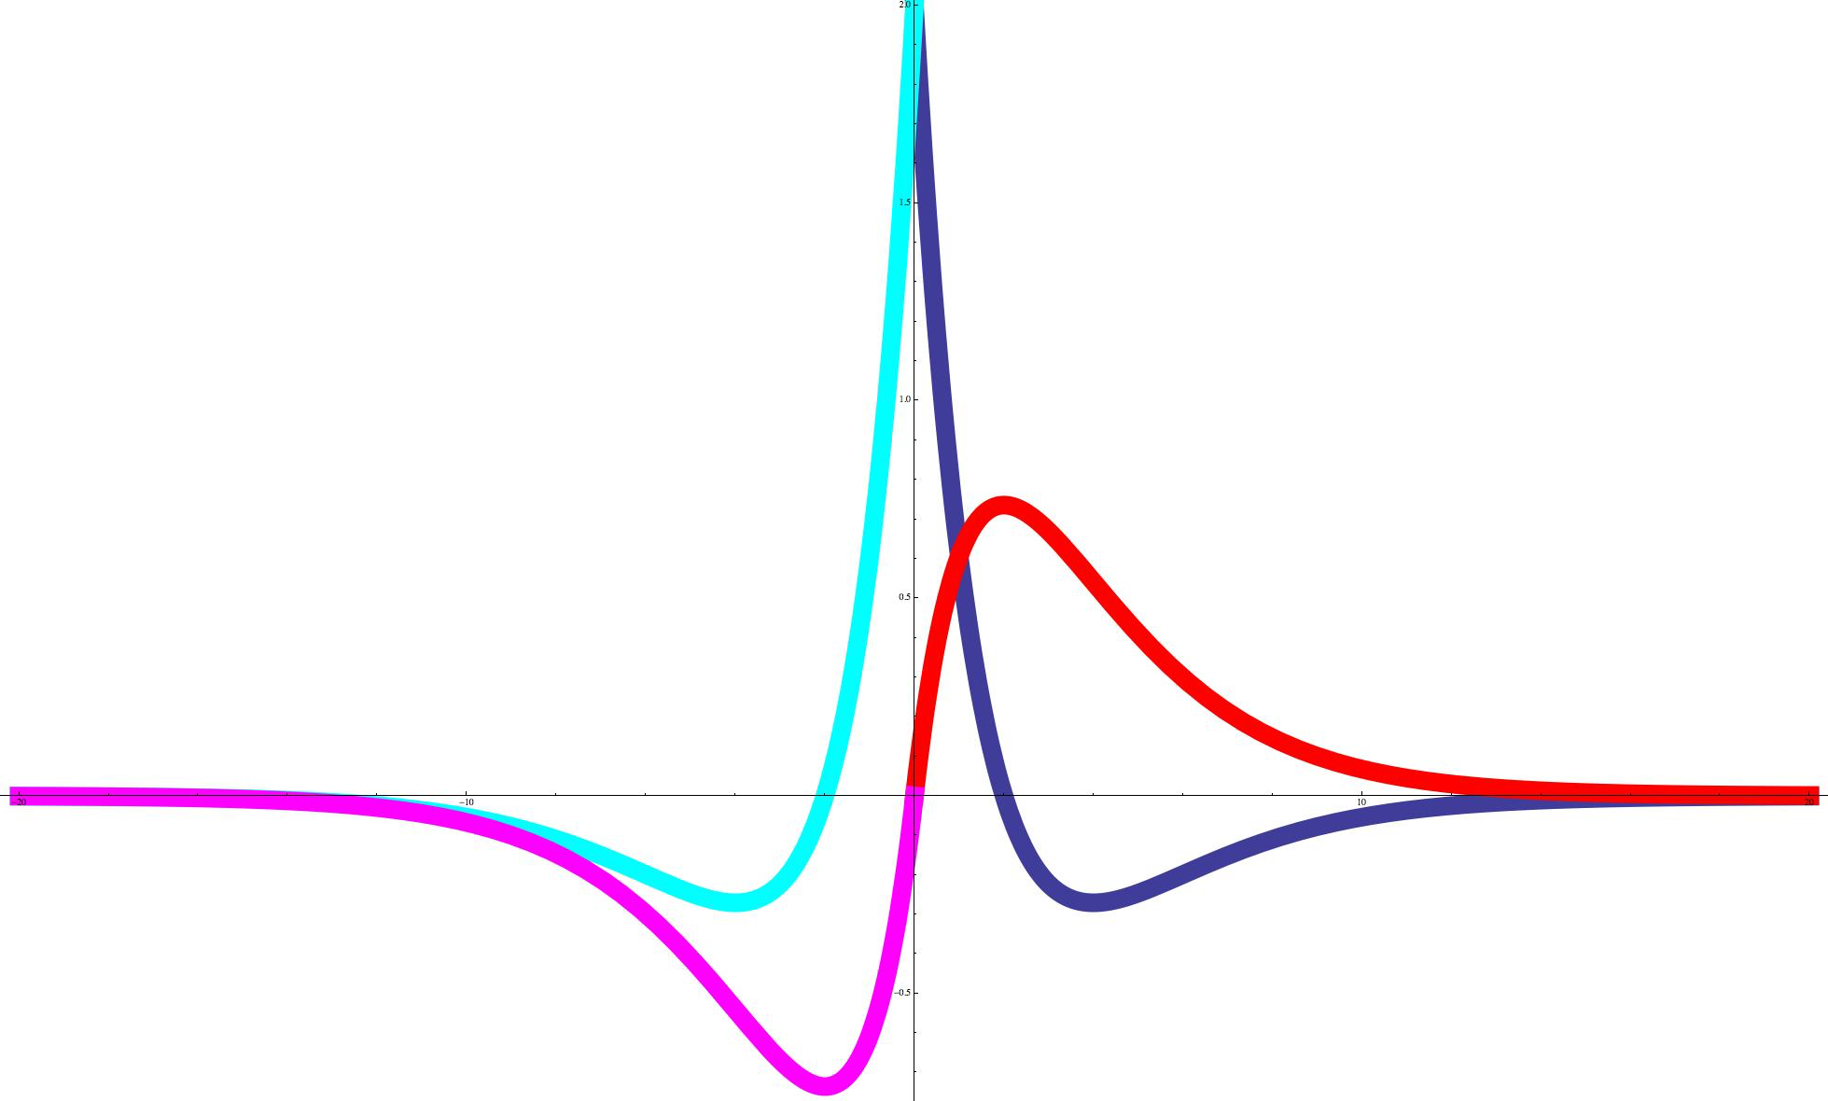
Sections of the orbitals
2s
2s
2p_{z}
2s
2p_{z}
2s

Slide 11
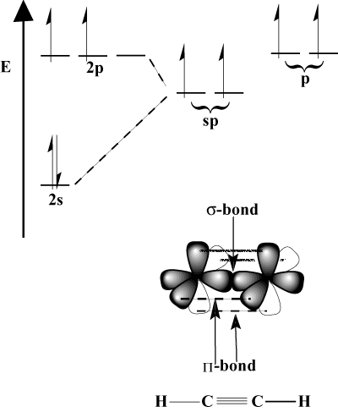
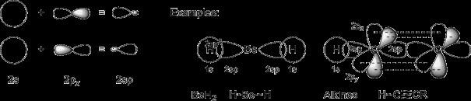
Bonding using sp hybrid orbitals
The other p orbitals are available for π bonding

Slide 12
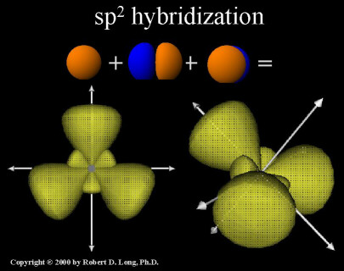
Trigonal geometry: Mixing s & two p orbitals
p_{x} and p_{y} can be combined with s to get three 3 equivalent hybrids at 120º to each other
+y
hy1
Θ₃
Θ₁
-x
+x
hy3
Θ₂
-y
hy2

Slide 13
Coefficients of AOs for specifically oriented sp² hybrid orbitals
30º
+y
+y
h1
+y
+x
+x
30º
30º
30º
+x
h2
h3

Slide 14
Coefficients from the conditions of Orthonormality
30º
h1
+y
30º
h3
+x
h2

Slide 15
Coefficients from the conditions of Orthonormality
30º
h1
+y
30º
h3
+x
h2

Slide 16
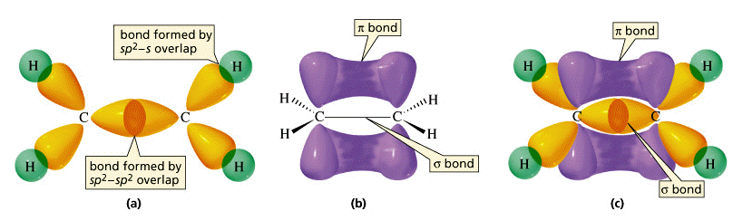
Signs and coefficients for these particular sp² hybrids
30º
h1
+y
30º
h3
+x
h2
Square of coefficients ➔ Contribution from s=0.33; from p=0.66

